Slide 1

Bioenergy Development: the Global Context
Validation Workshop on the ECOWAS Bioenergy Policy
Dakar, Senegal – 30 September 2015
Dr. Maria Michela Morese
Executive Secretary
Global Bioenergy Partnership
Food and Agriculture Organization of the United Nations (FAO)

Slide 2
Table of content
GHG emissions: data and projections
Bioenergy
    Role in the global energy context
    Policies
    Solid biomass
The Global Bioenergy Partnership (GBEP)
    History, objectives and members
    The Sustainability Indicators for Bioenergy
Barriers to Sustainable Bioenergy Development
Conclusions

Slide 3
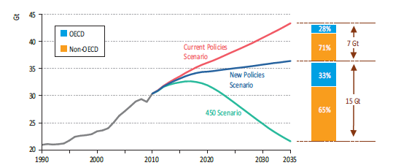
GHG emissions: data and projections
According to IEA, in order to contain the average global temperature increase within the 2°Celsius (if compared to 1990 levels) there needs to be substantial GHG emission reduction.
Non-OECD countries expected to play an important role.
Source: IEA, WEO 2012
Notes:
The International Energy Agency (IEA) presents different development scenarios with different impact on the global concentration of GHG and therefore different impacts on global temperatures.
According to IEA, in order to contain the average global temperature increase within the 2° Celsius (if compared to 1990 levels) there needs to be substantial GHG emission reduction.
A great deal of potential in emission reduction is expected to come from non-OECD countries (65% in orange in the picture).

Slide 4
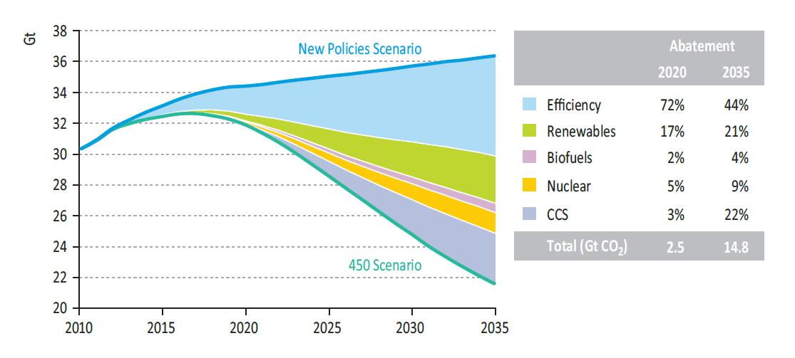
GHG emissions: data and projections
In the 450 ppm scenario, IEA foresees a specific role for bioenergy
Source: IEA, WEO 2012
Notes:
According to IEA, bioenergy has the potential to abate global GHG emission by 4% of total needs in order to stick within the 450 ppm/2°C scenario.

Slide 5
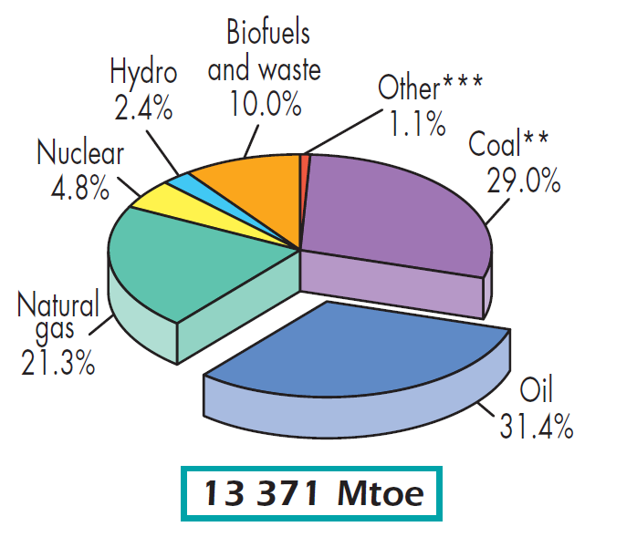
Bioenergy
In 2012 bioenergy production reached 1.34 billion tons of oil equivalent or about 10% of world primary energy supply (IEA, 2014).
Bioenergy is the fourth most important energy source worldwide and the first among the renewables
Source:
IEA, 2012: 2012 Technology Roadmap, Bioenergy for Heat and Power
IEA, 2013: 2013 Key World Energy Statistics
Notes:
Bioenergy accounted for roughly 10% (1340 million tons of oil equivalent) of world total primary energy supply (TPES) in 2012 , with most of this being traditional biomass in non-OECD countries.
This makes bioenergy the world’s fourth largest source of energy (following oil, coal, and natural gas).
In OECD countries, bioenergy supply mainly uses modern technologies and overall plays a considerably smaller role than in developing regions. Although bioenergy can be competitive with fossil fuels under favourable circumstances (when fossil fuel prices are high) in most cases of commercial use, support policies are needed to offset cost differences with fossil fuels.
Sources:
IEA, 2012: 2012 Technology Roadmap, Bioenergy for Heat and Power, International Energy Agency
IEA, 2013: 2014 Key World Energy Statistics, International Energy Agency - http://www.iea.org/publications/freepublications/publication/KeyWorld2014.pdf

Slide 6
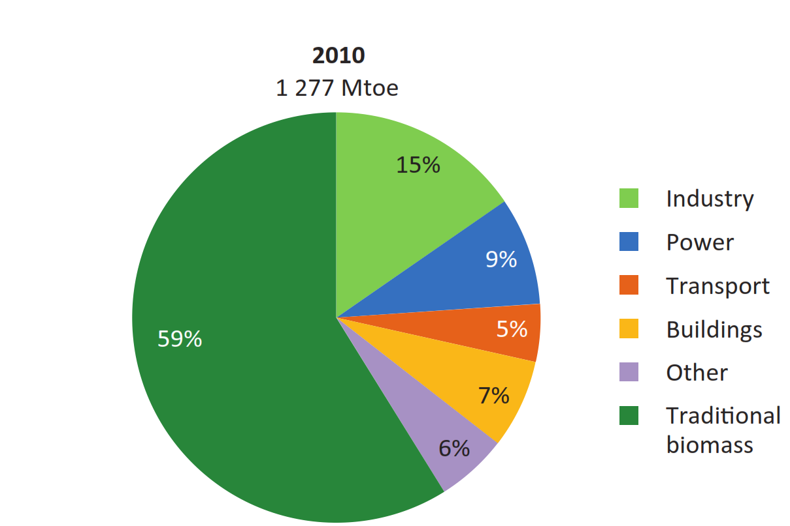
Bioenergy
About 60% of bioenergy produced is in the form of traditional biomass.
Whereas only 5% of the energy from biomass producted worldwide is employed in the transport sector.
Source: IEA, WEO 2012
Notes:
Excluding demand for traditional biomass, primary energy demand for bioenergy is largest in the European Union, (130 Mtoe in 2010) with industrial and residential heat accounting for nearly half of this demand.
From 2000 to 2010, global electricity generation from bioenergy grew by 6.9% per year, with larger increases in the OECD than in non-OECD countries. The increase in absolute terms was about half that of wind power but more than five times that of solar PV. By 2010, generation from bioenergy reached 331 TWh globally, accounting for over 40% of global non-hydro renewables generation.
Sources:
IEA, 2012b: IEA World Energy Outlook 2012, International Energy Agency

Slide 7

Bioenergy - Policies
ARGENTINA current mandate
Ethanol: 5%
Biodiesel: 8%
BRAZIL current mandate
Ethanol : 20%
Biodiesel: 5%
CHINA current mandate
Ethanol : 10% in 9 province
Target for 2020 Etanolo/Biodiesel: 10%
INDIA current mandate
Ethanol : 5%
Target for 2017 Etanolo/Biodiesel: 20%
Fonte: Global Renewable Fuels Alliance, 2015 and Biofuels Digest, 2014
EU current mandate
10% renewables in transport sector
(up to 7% from food crops)
INDONESIA mandates:
Ethanol : 3% -> 20% 2020
Biodiesel: 10% -> 30% 2020
MOZAMBIC current mandate
Ethanol : 10%
SUD AFRICA current mand.
Ethanol : 10%
USA current mandate
136 billion liters by 2022
Notes:
Most policies which deal with bioenergy regulate mainly the use of liquid fuels for the transport sector with few exceptions (notably the EU RED). However, increasing interest is being drawn towards the use of other forms of modern bioenergy, namely solid biomass for electricity generation.

Slide 8
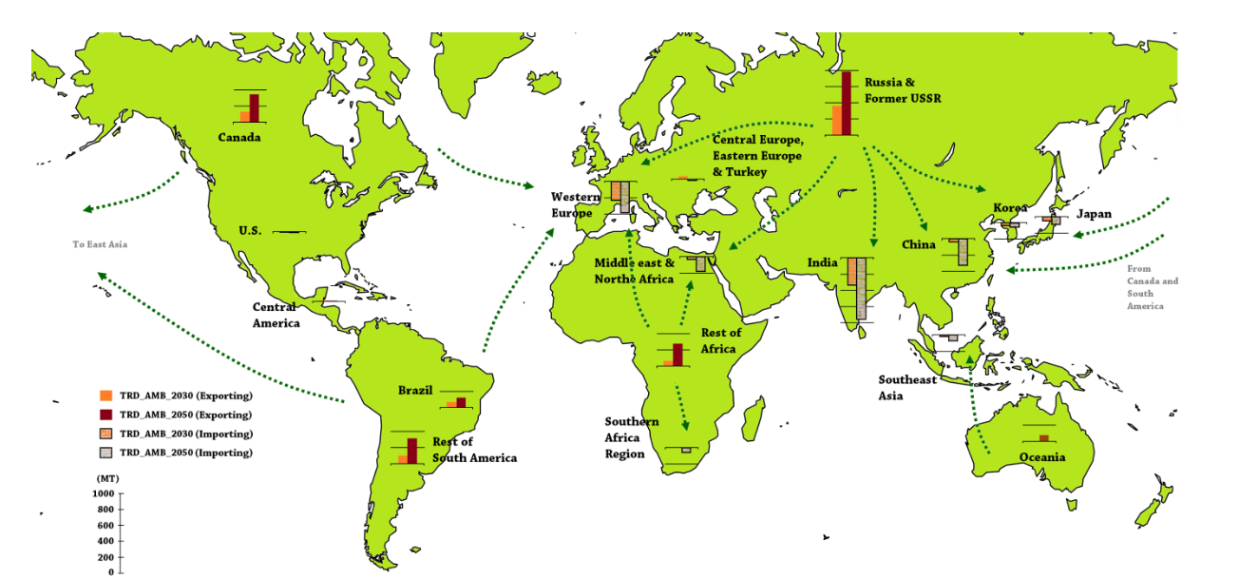
Bioenergy – solid biomass
Pellet production, trade and consumption –future scenarios (2030, 2050):
Europe, India e China main importers
Russia, Canada, Latin America and Africa main exporters
Source:
IEA Bioenergy Task 40: Future Perspective in Biomass Trade
Notes:
The map above describes how demand for solid biomass is traded between regions in 2030 and 2050 (orange and red bars respectively). In more detail, the model scenarios show a huge range of potential bioenergy trade: for solid biomass, in ambitious scenarios bioenergy trade ranges from 700Mt to more than 2,500 Mt in 2030 and from 800 Mt to almost 4,200 Mt in 2050. Russia and Canada are expected to be major exporters; Western Europe and India, major importers.
By 2050 Africa is also expected to be a net exporter of solid biomass.
Without harmonized policies however, risks for sustainability are evident. This is the reason why global initiatives like the Global Bioenergy Partnership are needed for facilitating high level policy dialogue on these impellent themes.
Source:
IEA Bioenergy Task 40: Future Perspective in Biomass Trade
http://www.bioenergytrade.org/publications.html#Future

Slide 9
The Global Bioenergy Partnership (GBEP)
GBEP was established to implement the commitments taken by the G8 in 2005 to support “biomass and biofuels deployment, particularly in developing countries where biomass use is prevalent”
GBEP aims mainly to:
Promote high-level policy dialogue on bioenergy and facilitate international cooperation;
support national and regional bioenergy policy-making and market development;
favour the transformation of biomass towards more efficient and sustainable practices; and
foster exchange of information, skills and technologies through bilateral and multilateral collaboration.

Slide 10
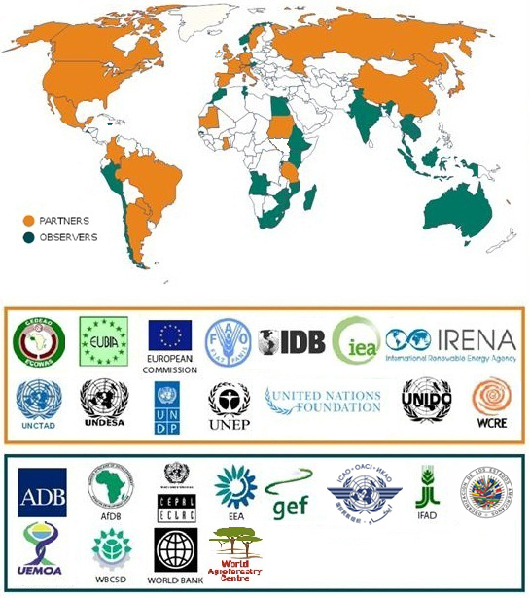
GBEP Membership
Notes:
Among its partners and observers, GBEP includes ECOWAS and governments of the West African Region

Slide 11
GBEP Sustainability Indicators for Bioenergy
GBEP has developed a set of 24 indicators for the assessment and monitoring of bioenergy sustainability at national level
The GBEP indicators cover each of the three pillars of sustainability and address the production and use of all liquid, solid and gaseous biofuels for heating and cooking, electrification and transport
ENVIRONMENTAL SOCIAL ECONOMIC

Slide 12
Implementation of the Sustainability Indicators
COUNTRIES | COMPLETED | IN PROGRESS | COMMITTED
Argentina |  | X
Brazil |  | X
China |  |  | X
Colombia | X
Egypt |  | X
Ethiopia |  |  | X
Germany | X
Ghana | X
Indonesia | X
Italy |  |  | X
Jamaica |  | X
Japan | X
Kenya |  |  | X
Netherlands | X
Paraguay |  |  | X
USA |  | X
Sudan |  |  | X
Uruguay |  | X
Vietnam |  |  | X

Slide 13
Barriers to Sustainable Bioenergy Development: Policy Frameworks
Lack of coordination among relevant sectors and related policies and institutions (e.g. energy, agriculture, environment, etc.)
Lack of coherent and stable policy frameworks
HOW GBEP
HELPS…
Since 2006, GBEP has been fostering institutional coordination, multistakeholder dialogues and policy dialogues at both national and regional levels

Slide 14

Barriers to Sustainable Bioenergy Development: Lack of Evidence – Potential & Sustainability
Lack of understanding of biophysical and especially techno-economic potential of bioenergy, as well as of the environmental, social and economic sustainability of bioenergy
The GBEP indicators are contributing both to the generation of evidence and to assess the sustainability of bioenergy production and use
Lack of evidence-based and political support for bioenergy policies

Slide 15
Barriers to Sustainable Bioenergy Development: Data and Skills
Lack of effective strategies and mechanisms for data collection and management
Limited availability of – and access to – data
Lack of skills and capacity to undertake necessary analysis
GBEP is compiling the necessary data, with a
view to filling data gaps, and is strengthening
the capacity of relevant institutions

Slide 16
Conclusions
Bioenergy has the potential to reduce GHG emissions and offer opportunities to agriculture and forestry sectors;
West Africa could play an important role
Sustainability is key;
Monitoring sustainability is a necessary step in order to understand, evaluate and improve the performances of the sector
GBEP is actively working on the diffusion of sustainability in the processes of production and use of bioenergy resources with several activities and tools, including the GBEP Sustainability Indicators for Bioenergy
Particularly for policymakers GBEP represents an important forum for discussion and harmonization policies

Slide 17
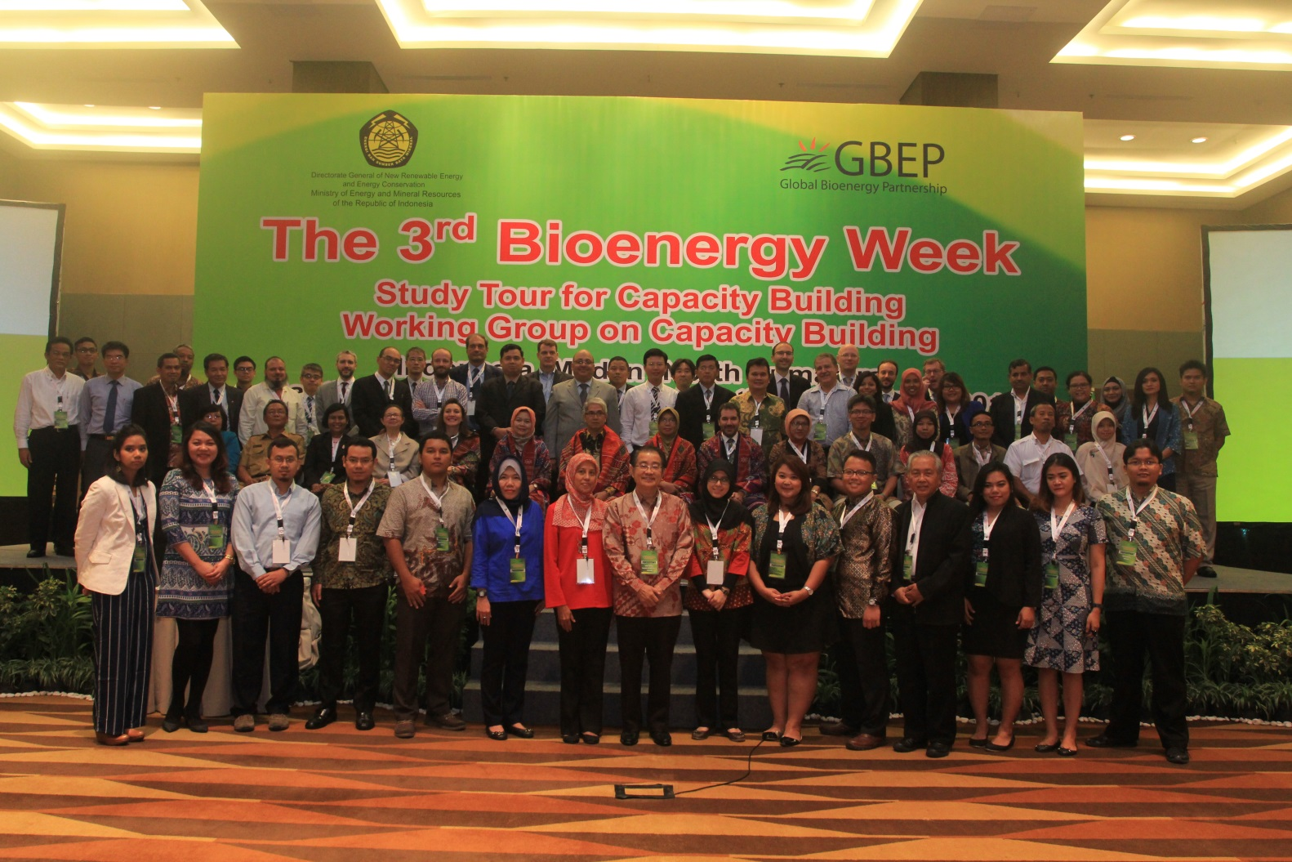
Thank you
GBEP-Secretariat@fao.org
http://www.globalbioenergy.org

