Slide 1


ECOWAS Bioenergy Policy and implementation plan Prepared With the financial and technical support of UNDP, Regional Energy Project for Poverty Reduction Dakar -30 September -01 October 2015
Prepared by Demba Diop (ddiop@antenna.nl - EPM Consulting) for ECREEE
9/29/15
www.ecreee.org
1

Slide 2


Table of Contents
Energy Access
Regional Goals and Targets
Unmapped Resources
Knowing the resources
Biomass as the cheapest source of bioelectricity in ECOWAS countries
Large potential for bioelectricity from biomass residues
Types of resources
2

Slide 3
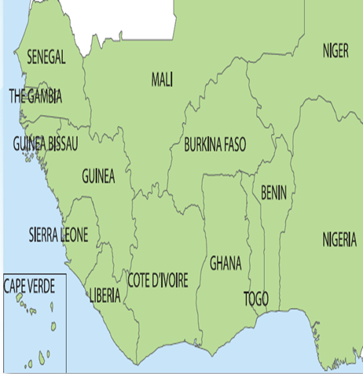
Current Bioenergy Situation: Energy access
By 2020, West Africa, home to appr. 350 million peoples, a 1/3 of the African.
Considerable challenges; 11 of its 15 nations are Least Developed Countries (LDCs).
30 % of access to electricity; wide gaps between urban and rural areas and between countries.
The rural poor spend more of their income on (poor quality) energy services than the better‐off spend on (better quality) services.
Traditional biomass accounts for 80% of the energy for cooking (ECREEE, 2012).
3

Slide 4
Current Bioenergy Situation Energy access
Energy access
Growing gap between predicted electricity demand, existing supply capacities and limited capital to invest.
The little energy that is generated is used inefficiently: an estimated 40% technical and commercial electricity losses.
In some countries even more than 90% of the electricity generation is satisfied by expensive imported diesel or heavy fuel
Rural electrification rate very low with less than 10% in Guinee Conakry, Niger, Liberia, Guinea-Bissau, Sierra Leone.
Lack of access to modern energy services is a critical barrier for education, health, income generation and gender.
4

Slide 5
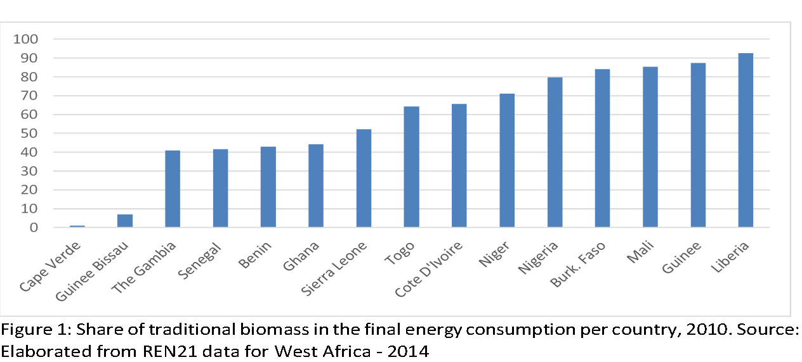
Current Bioenergy Situation: Energy access
ACCESS TO MODERN ENERGY SERVICES
People’s revenues are often insufficient to cover the costs of running (diesel) generators. This situation requires heavy support (in the form of subsidies) from central governments.
5

Slide 6
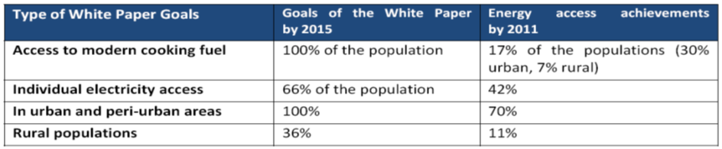
Current Bioenergy Situation Regional Goals and Targets
ECOWAS/UEMOA White Paper,
a regional policy that seeks to considerably increase the rate access to energy services for populations and an acceleration of development process towards achievement of the MDGs
White Paper goals and achievement by 2011
6

Slide 7
Current Bioenergy Situation
ECREEE Renewable Energy Policy (EREP)
The EREP vision is to secure an increasing and comprehensive share of the Member States’ energy supplies and services from timely, reliable, sufficient, cost-effective uses of renewable energy sources enabling:
Universal access to electricity by 2030
A more sustainable and safe provision of domestic energy services for cooking thus achieving the objectives of the White Paper for access to modern energy services by 2020.
Three groups of targets are set by the EREP:
grid-connected renewable energy applications;
off-grid and stand-alone applications; and
domestic renewable energy applications.
7

Slide 8
Current Bioenergy Situation
ECREEE Energy Efficiency Policy Targets
The specific target of the regional policy is to implement efficiency measures that free-up 2000 MW of power generation capacity by 2020, through the following actions:
lighting: phase out inefficient incandescent bulbs by 2020;
electricity distribution: reduce losses in electricity distribution, from the current range of 15% to 40%, to under 10% by 2020;
cooking: achieve universal access to safe, clean, affordable, efficient and sustainable cooking for the entire population of ECOWAS, by 2030;
standards and labels: establish an ECOWAS Technical Committee for Energy Efficiency Standards and Labelling, and adopt initial region-wide standards and labels for major energy equipment;
Building Code: develop and adopt region-wide efficiency standards for buildings;
finance: create instruments for financing sustainable energy, establish a regional fund for the development and implementation of sustainable energy projects.
8

Slide 9
Current Bioenergy Situation
Unmapped Biomass Resources
The region holds more than 60% of the world production of cocoa (Ivory Coast, Ghana, Nigeria).
World leader of cassava research and production (Nigeria)
Good share of the world production of coffee, groundnuts, sheanuts, rice, millet, sorghum, cashew nuts, palm oil, coconuts, etc.
Highest yield of sugar cane (135 ton per hectare in North Senegal as compared to a an average of 100 ton in Brazil
Straw, husks, stalks, shells and other resources are rather burned or abandoned on the fields after harvest while these resources could improve farmer’s revenues
9

Slide 10
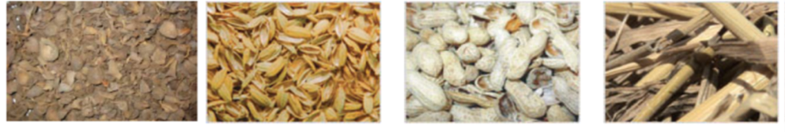
Current Bioenergy Situation
Knowing the resources
Most of the food and export crops in the region are source of wastes and residues (cocoa, coffee, palm oil, ground nuts, rice, sheanuts, etc) that require marginal investments to be collected for energy production.
Most of the infrastructure for export exists already as in the case of coffee, cacao, groundnuts, cotton, sheanut, cashew, etc.
These individual and collective infrastructures (drying, grading, pressing, etc) can serve as the backbone of the bioenergy supply chain in the Region and create more jobs.
10

Slide 11
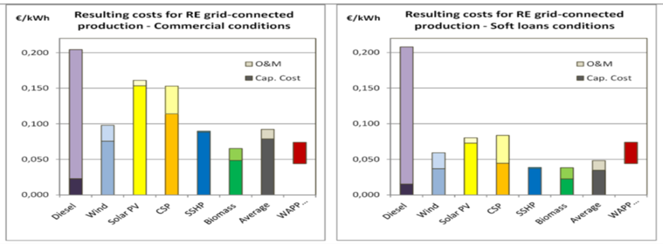
Current Bioenergy Situation Biomass as the cheapest sources of bioelectricity in ECOWAS countries
bioenergy is one of the cheapest sources of bioelectricity in the Region as reported in the baseline study of ECREEE in 2011.
11

Slide 12

Current Bioenergy Situation Large potential for bioelectricity from biomass residues
UEMOA /ITLIS study: the potential from agricultural residues of 55 billion kWh per year, equivalent to 20.7 billion litres of diesel or 148 million barrels of oil
The region could readily turn into a net energy exporter if solely 15% of its biomass residues potential energy is exploited.
At ECOWAS level, with the addition of humid and resource-rich countries such as Guinee Conackry, Liberia, Sierra Leone, Ghana and Nigeria, the potential for bioenergy could make the region an energy power house.
 | Need (bil­lions kWh) | Potential (billions kWh) | Eq. Diesel (Million litres) | Eq. Barrel of oil (Million) | Eq. million USD (year 2008)
Benin | 0,60 | 6,20 | 2 336 | 17 | 1 168
Burkina Faso | 0,50 | 10,00 | 3 746 | 27 | 1 874
Cote d’Ivoire | 2,60 | 17,20 | 6 465 | 46 | 3 234
Guinée B | 0,10 | 0,50 | 188 | 1 | 94
Mali | 0,80 | 8,00 | 2 989 | 21 | 1495
Niger | 0,50 | 6,30 | 2370 | 17 | 1186
Senegal | 1,90 | 2,90 | 1094 | 8 | 547
Togo | 0,60 | 4,00 | 1514 | 11 | 757
TOTAL | 7,90 | 55,10 | 20 701 | 148 | 10 356
12

Slide 13
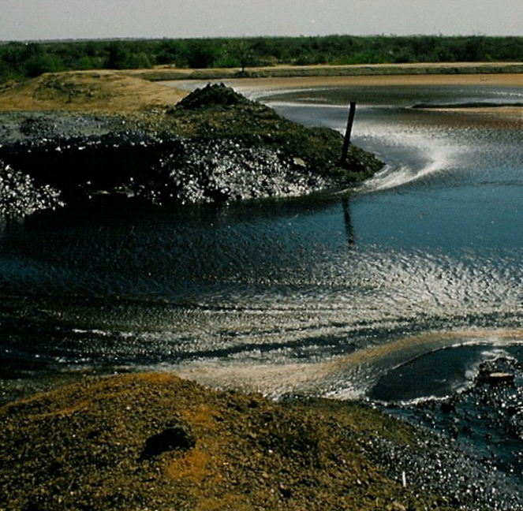
Current Bioenergy Situation What are the Types of resources
Dumped molasses in north Senegal (Demba Diop, 2004)
Agroresidues
World largest producer of cocoa (7 to 9 tons of waste 1 ton of dry cocoa). Coffee, sheanuts, palm oil, rice husk, groundnuts, cotton, millet, sorghum, coconuts, etc.
Municipal by-products :
Landfill gas for energy generation
Avoid uncontrolled dumping
13

Slide 14
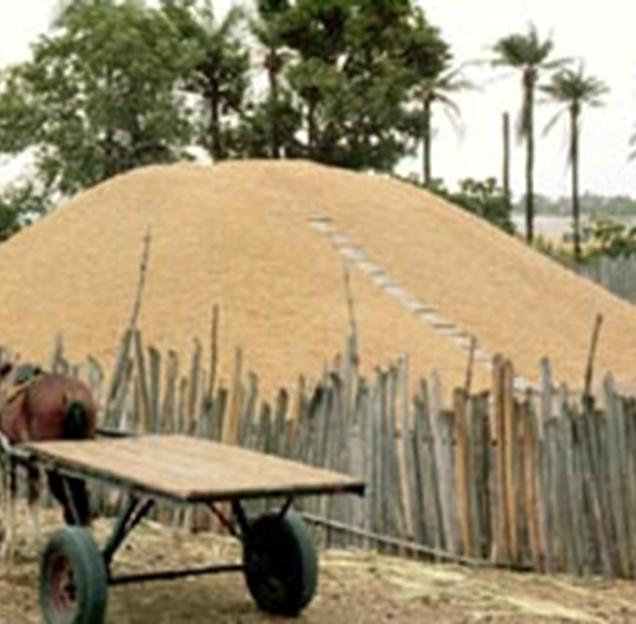
Current Bioenergy Situation Types of resources
Groundnuts Senegal
Woodfuels
almost all woodfuels used are direct;
Wood consumption is well above the annual increment (desertification);
Residues (e.g. sawmills) are left unused;
Agrofuels
Ethanol: sugar cane, sweet sorghum, cassava
Biodiesel : palm oil , palm kernel oil, cottonseed oil, peanut oil, Jatropha oil, coconut oil and the Neem tree.
14

Slide 15
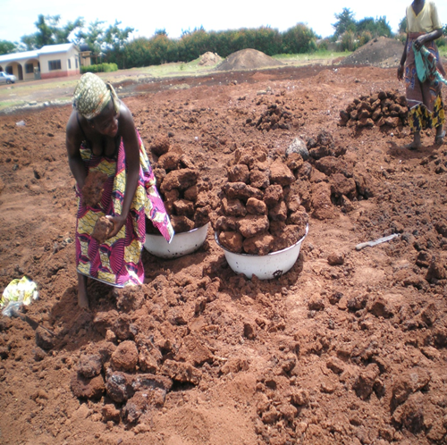
Current Bioenergy Situation Types of resources
Residues of sheanut at shebou factory, North Ghana
Larges amount of residues from shea in Burkina Faso, Mali, Ghana, Togo. Only in Togo, about 18 000 tones of shea butter residues can be captured for energy generation
Wasted cashew apple in Guinea Bissau, Ghana, Ivory Coast could serve for ethanol production.
The region enjoy large population of tree bearing oil (neem seeds, baobab, etc) that can meet up a consistent part of the imported diesel in the Sahel countries.
15

Slide 16
Current Bioenergy Situation
Relevance of Bioenergy to the target and needs of the Region
Decrease health diseases and improve gender implications
Yearly, thousands of West Africans die from respiratory diseases due to kitchen smoke while children and women spend a great amount of time collecting fire wood for daily subsistence at the detriment of education or other rewarding activities..
Attract investments to agriculture and improve sustainable land use and productivity
Improve food security
Use of slurry (residues of biogas production) and nutritive ash (residues of gasification process) can improve greatly agriculture yields for the smallholders. Modern bioenergy strengthens equally commercial farming as it provides extra revenues for the farmers and enhance the environment.
16

Slide 17
Current Bioenergy Situation
Relevance of Bioenergy to the target and needs of the Region
Improve government budgets, balance of payment and energy security
Utilisation of domestic and agro processing wastes for energy applications might result in savings for national governments, reduced foreign expenditure, reduced subsidies for imported fuels and improved budget controls.
Impacts on biodiversity and natural resource management and contribution to climate change mitigation
By adopting policies that ban the poor practices of slash and burn practices as a way to clear land.
17

Slide 18
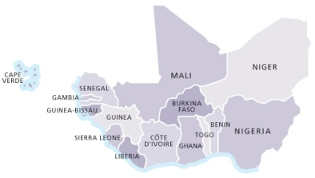

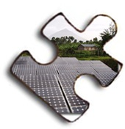



Thank you! Merci! Muito obrigado!
Achada Santo Antonio, 2nd Floor, Electra Building, C.P. 288, Praia – Cape Verde Tel: +2382624608, +2389225454 skype: info-ecreee info@ecreee.org
9/29/15
18

Slide 19
Policy Implementation strategy Key Areas for Bioenergy Policy
Main groups of biomass feedstock:
Solid biomass (wood, crop residues, agro-processing residues)
Digestible organic wastes (dung, nightsoil, waste water, etc.)
Sugars and starches
Vegetable oils and fats
Main conversion processes:
Combustion, including stoves (heat / electricity)
Gasification (electricity / heat)
Densification (briquettes, pellets)
Carbonisation (charcoal)
Anaerobic digestion (electricity / heat / mechanical power)
Fermentation / distillation (ethanol)
Extraction / transesterification (PPO / biodiesel)
19

Slide 20
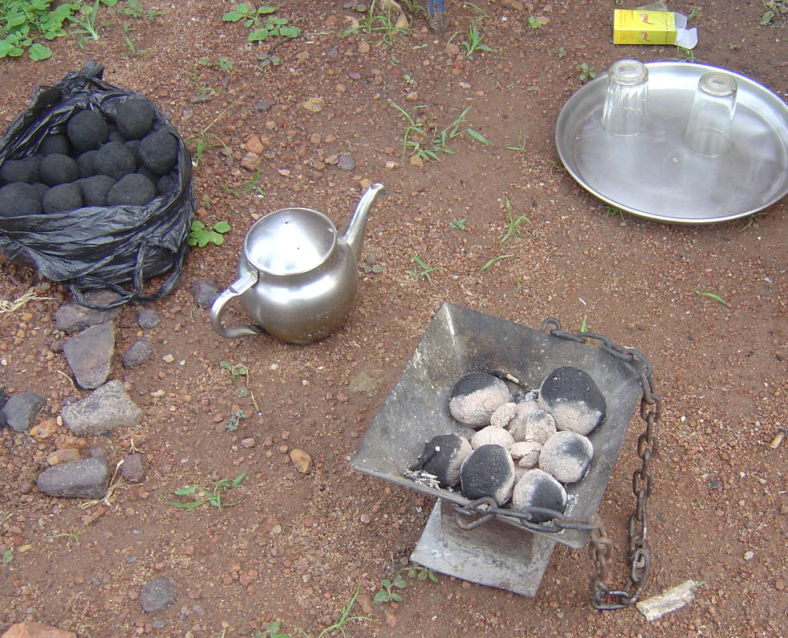
Policy Implementation strategy Key Areas for Bioenergy Policy
1. Wood, crop residues, agro-processing residues
Improved cooking stoves: in combination with solid biomass fuels. High fuel efficiency, reduced indoor pollution. Must be bought but typically highly economic investment
Carbonisation: charcoal from wood or other lignocellulotic biomass. Improved production methods have higher efficiency and lower emissions but can have high investment costs
Charcoal briquettes produced from cotton stalk in Mali
20

Slide 21
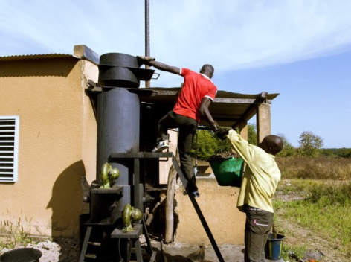
Policy Implementation strategy Key Areas for Bioenergy Policy
Densification: biomass briquettes and pellets from solid biomass. Mainly for domestic energy; can replace fuelwood (reduce deforestation) but often more expensive
Gasification: conversion of solid biomass into gas for electricity production and industrial heat. Relatively efficient and limited investment costs, but difficult to operate and maintain
Rice husk gasifier in Dano, Burkina Faso
21

Slide 22
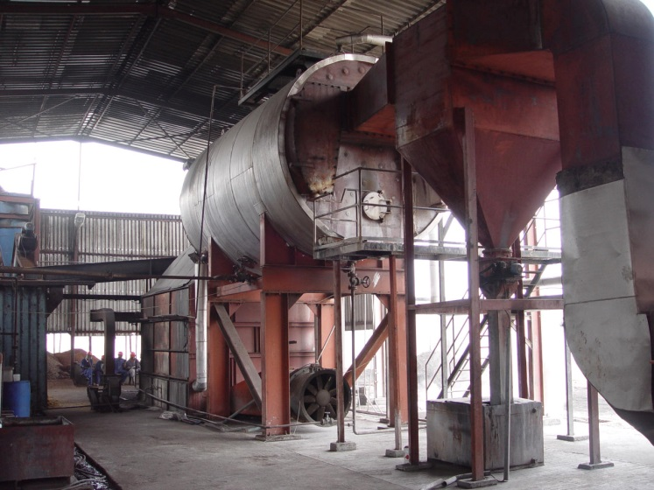
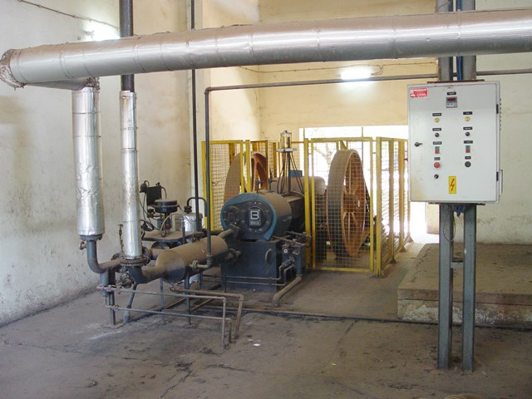
Policy Implementation strategy Key Areas for Bioenergy Policy
Combustion for CHP / industrial heat: typically grid connected systems. Efficient at larger scale, but high investment costs and large biomass quantities required.
EFB fired steam boiler at 450 kWe CHP plant of Juaben oil mill, Ghana
60 kWe Steam engine run on cashew shell at SICAJU in Guinea Bissau
22

Slide 23
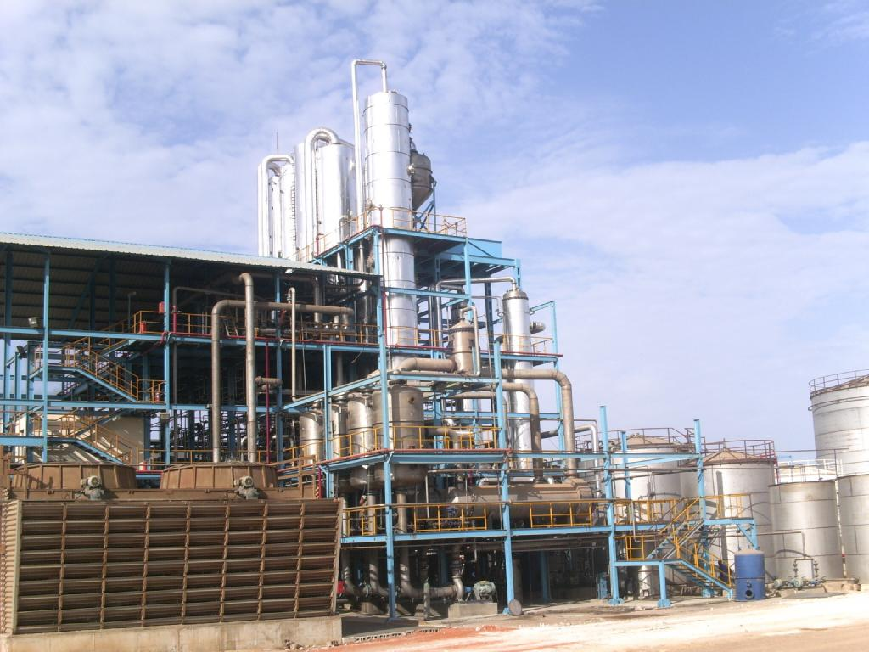
Policy Implementation strategy Key Areas for Bioenergy Policy
3. Sugar, starch
Bioethanol: from fermentation of sugars and starches and subsequent distillation / rectification. Use as automotive fuel (blending with gasoline). Large scale production is efficient but high investment costs.
Liquid household fuels: in liquid or gellified form, used in dedicated household stoves. Clean but relatively expensive.
12 million l/a ethanol plant at CSS sugar factory in Richard Toll, Senegal
23

Slide 24
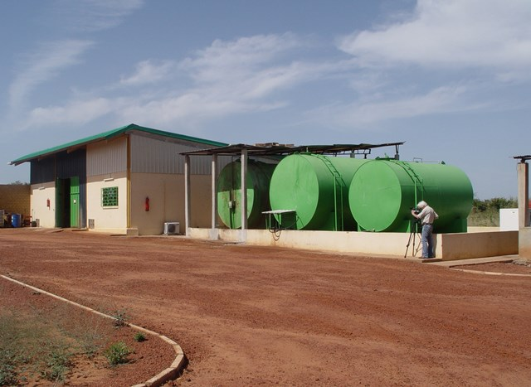
Policy Implementation strategy Key Areas for Bioenergy Policy
4. Vegetable oils and fats
Pure Plant Oil: for use in (adapted) diesel engines. PPO can be produced locally – attractive in remote areas. Issues are potential food market distortions and oil quality.
Biodiesel: for use in diesel engines, neat or blended. Produced through transesterification of oils or fats. Industrial process, cost-efficient at larger scales.
2000 l/d biodiesel plant of Mali Biocarburant, Mali
24

