Slide 1

BIOENERGY STRATEGY DEVELOPMENT IN THE ECOWAS REGION
John Yeboah
Program Officer
WWW.ECREEE.ORG

Slide 2
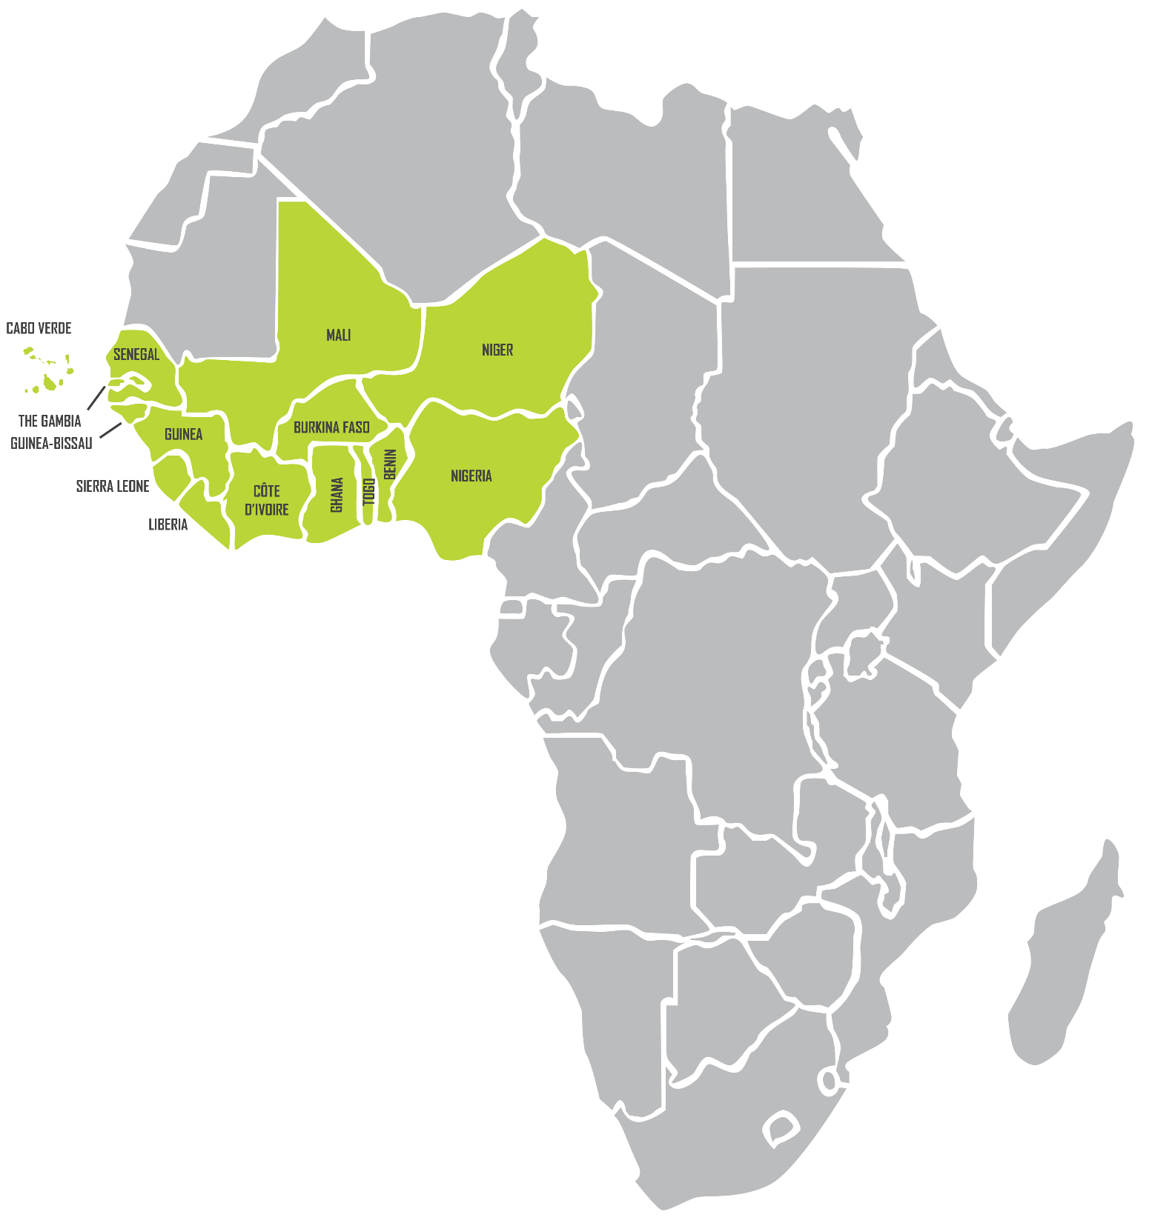

PRESENTATION OUTLINE
Introduction: The ECOWAS Region and Establishment of ECREEE
Bioenergy Challenges and Potentials
Opportunities for Sustainable Energy Services from Bioenergy
Case Study: ECREEE Sustainable Bioenergy program.

Slide 3
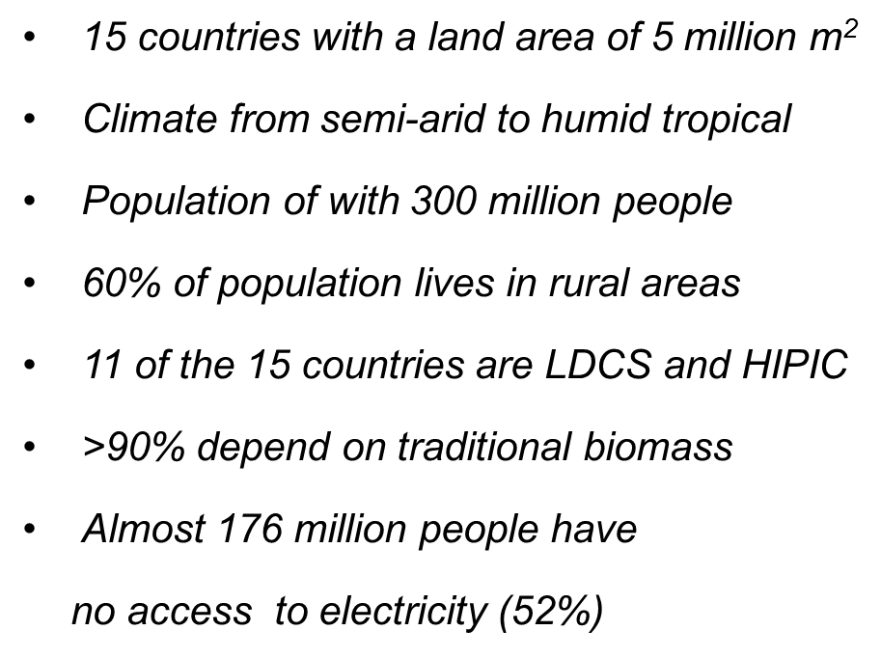
Introduction: THE ECOWAS REGION

Slide 4
FOUNDATION of ECREEE
  The Ouagadougou Declaration from 12 November 2007 highlighted the need for a regional RE&EE Centre
  Foundation laid by Regulation C/REG.23/11/08 of the 61st Session of ECOWAS Council of Ministers in Ouagadougou, Burkina Faso, on November 23, 2008
  Launch of the ECREEE preparatory phase in November 2009 with support of the ECOWAS Commission in collaboration and support from the core donors:

Slide 5
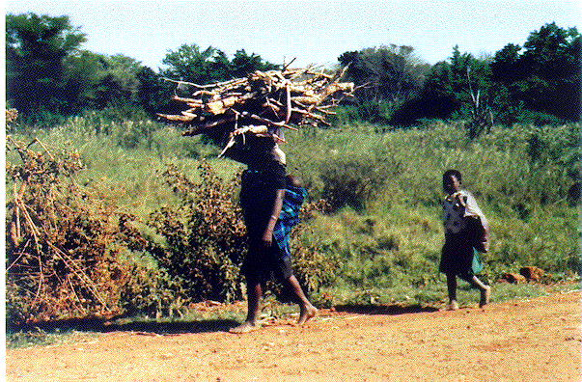
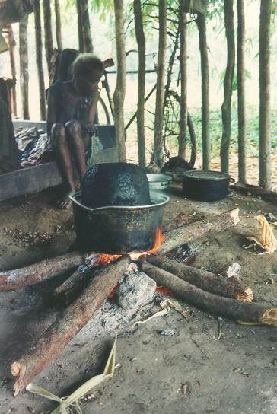
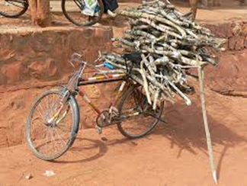
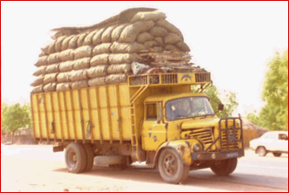
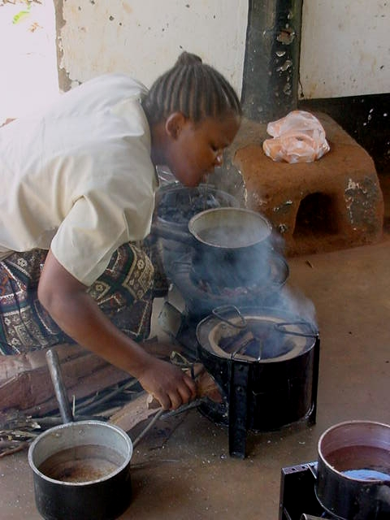
CHALLENGES & POTENTIALS FOR BIOENERGY

Slide 6
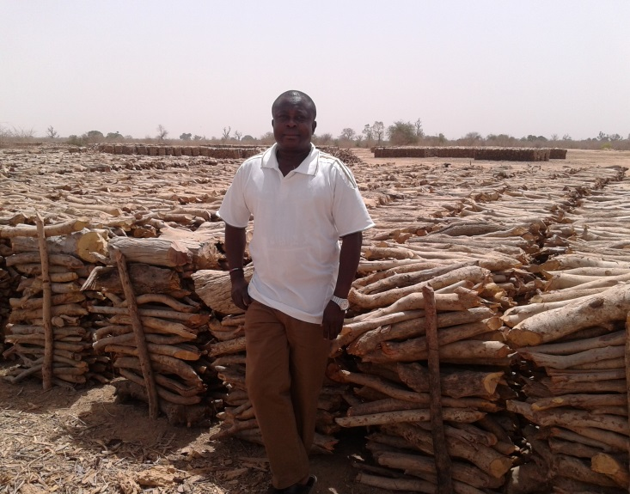
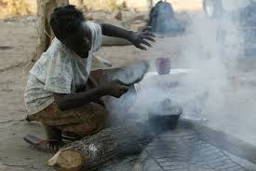
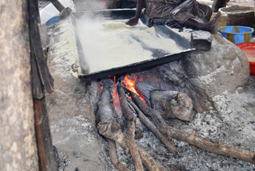
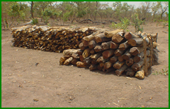
CHALLENGES OF BIOENERGY INDUSTRY
widespread and unsustainable harvesting & utilization of traditional biomass
almost 80% of the total energy consumption comes from the traditional biomass.
In addition, over 90% of the population uses wood and charcoal for domestic cooking.
ccC

Slide 7
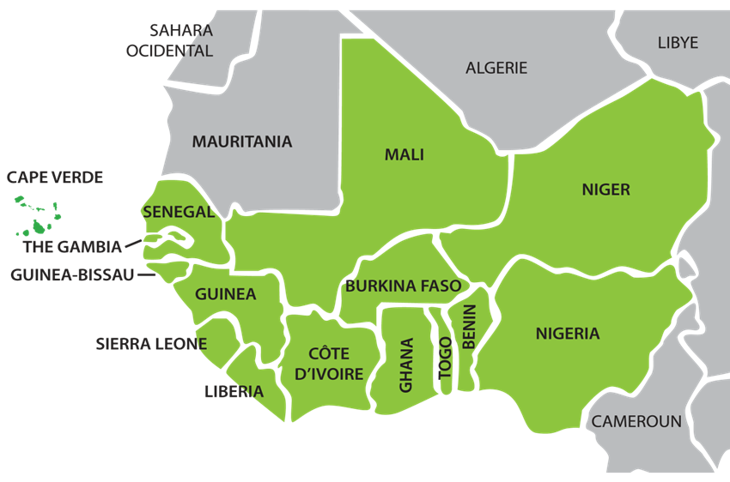
BIOENERGY RESOURCE POTENTIALS
Huge potential for all forms of bioenergy (e.g. Sustainable biomass, biogas, biofuel, waste-to-energy for electricity, briquettes)
Agro-industrial waste and by-products. Most of which is burnt in the open.
Animal/human waste used directly on the farms: more often
Municipal solid wastes & slurry from abattoirs
.

Slide 8
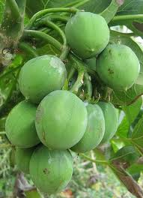

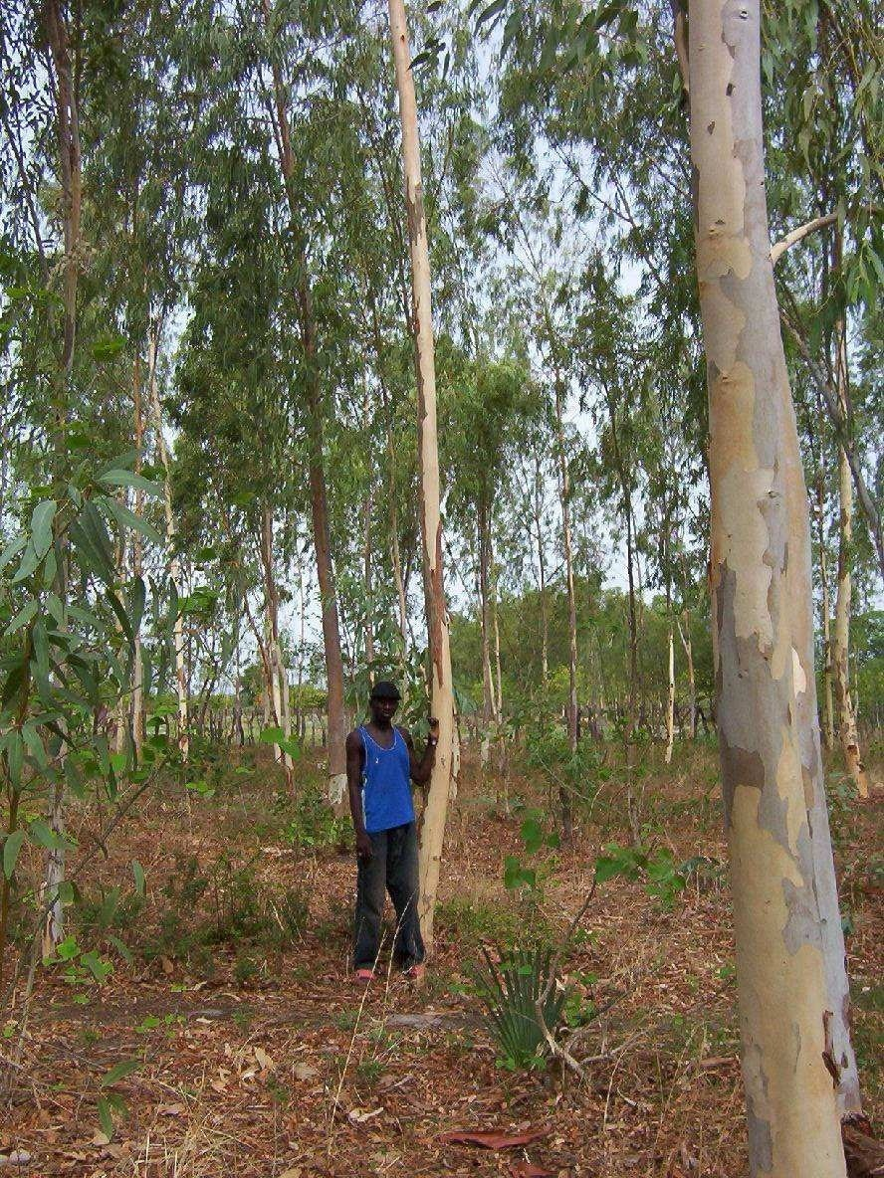
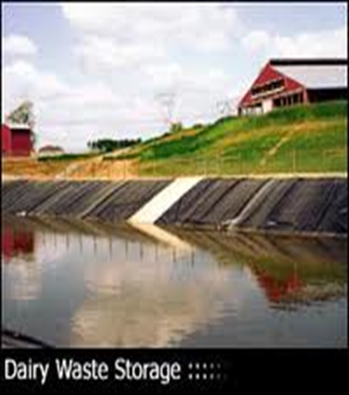
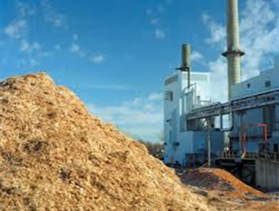
BIOENERGY RESOURCE POTENTIALS
Biocrops as fuel substitution & export of excess
Sustainable forest m’gt (agro-forestry,
Waste to energy (Sewage, MSW, Slurry
.
Biogas and Briquettes from agro-industrial wastes

Slide 9
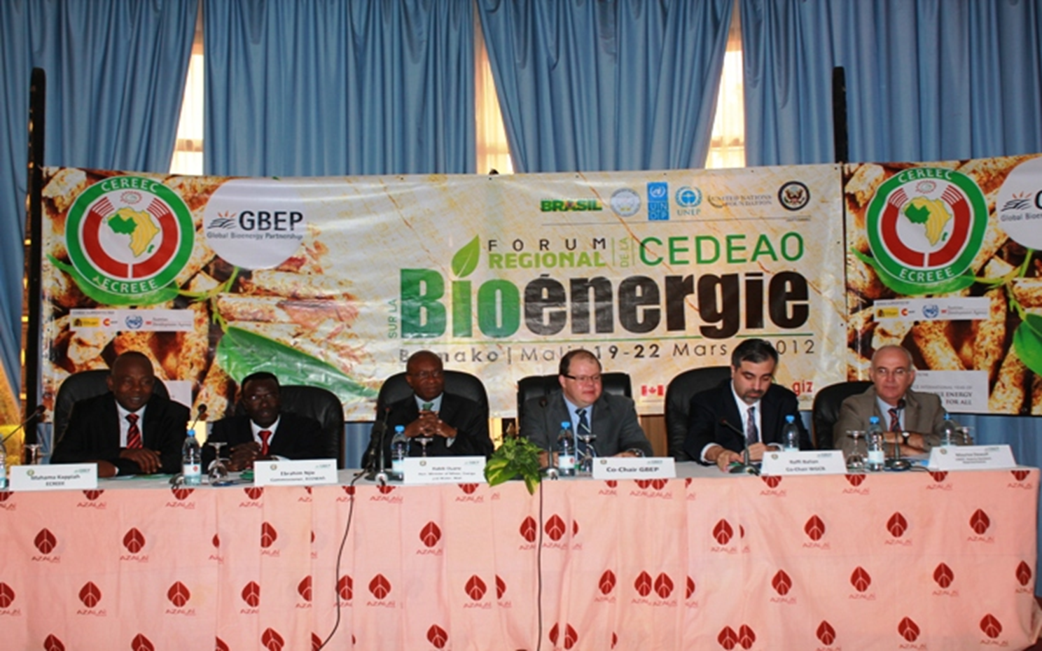
ECOWAS BIOENERGY INTERVENTIONS
.

Slide 10
ECOWAS BIOENERGY STRATEGY
  1. ECOWAS BIOENERGY POLICY DEVELOPMENT
ECOWAS Bioenergy Strategy Framework- formulated and validated at a regional workshop in Bamako, Mali in March 2012
The Bioenergy Strategy framework adopted at the HLF on Sustainable Energy in Accra, Ghana - Oct. 2012, by the ECOWAS Ministers of Energy for the 15 MS
ECOWAS Bioenergy Policy Document (Dakar, Sept.-Oct, 2015)
.

Slide 11
ECOWAS BIOENERGY STRATEGY cont.
  2. THE WEST AFRICA CLEAN COOKING ALLIANCE (WACCA)
Initiated by ECREEE and Partners at the HLF on Sustainable Energy in Accra, Ghana in October 2012
Aim:
  To disseminate clean, efficient and affordable cooking fuels and devices to all ECOWAS citizens by 2030 ( Devices- clean cookstoves, Fuels- woodfuels, charcoal, briquettes, LPG, bioethanol etc.)
  Regional workshop to formulate and validate Regional Action Framework held in Ouagadougou in April, 2013
  National workshops for Clean cooking Action framework held for the Gambia and Cote d’Ivoire in 2014
  Ongoing 2015 activities well planned to promote objective of the WACCA initiative
.

Slide 12
ECOWAS BIOENERGY STRATEGY cont.
  3. THE REDD+ PROGRAM
ECREEE initiated the REDD+ programme in 2013 supported by the Austrian Ministry of Forestry, Environment and Water Management.
Aim:
Effective and efficient management of the forest resources through
participatory forest management by the local people;
Providing opportunity to the rural people to harvest and trade their biomass
in a sustainable and efficient manner
Provide sustainable and efficient management tools for the supply of woody
resources; and
Ensuring the forests are protected to promote regeneration and the
ecosystem remains preserved.
.

Slide 13
CONCLUSION
  These strategies have led to:
  The Bioenergy policy which is now on the table for validation
  WACCA regional Action Plan document to be reviewed and validated tomorrow
  Forest resources assessment report to be considered on Friday
  All to give off their best for us to have these documents validated to promote sustainable bioenergy in the region.
.

Slide 14





Thank You! Merci! Obrigado!
.

