Slide 1


ECOWAS Bioenergy Policy and implementation plan Prepared With the financial and technical support of UNDP, Regional Energy Project for Poverty Reduction
Prepared by Demba Diop Bart Fredericks (EPM Consulting) for ECREEE
Dakar (Senegal) - 1 October 2015
9/28/15
www.ecreee.org
1

Slide 2


Content
The Regional Policy Building Blocks
Vision
Objectives
Monitoring & Evaluation
Implementation Strategies
2

Slide 3
Rationale, vision and objectives
Why a Regional Context ?
Bioenergy production, trade, use and policy implications transcend national borders.
Biomass policies become ineffective when they are not supported and integrated at both regional and national levels.
Therefore, policy coherence and long-term effects are best realised under a regional context. The Region is poised to play the role of harmonising approaches leading to a viable modern bioenergy sector.
3

Slide 4
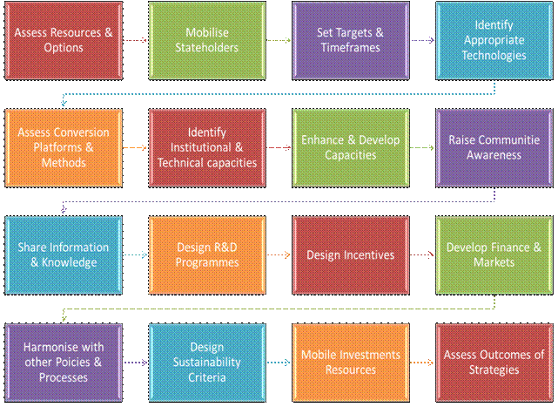
Rationale, vision and objectives
4

Slide 5
Rationale, vision and objectives
Rationale
Provision of energy services to the poor
Sustainable energy services from biomass resources could be among the cheapest options in the region, especially when sourced locally. Converting residues and wastes (straw, stalk, shells, etc.) into biogas, electricity and heat.
Promotion of agro-industrial development and job creation
Properly designed, socially inclusive and environmentally responsible waste-based bioenergy that involve small-scale producers can contribute to poverty alleviation.
Reducing health risks and addressing gender imbalance
The underlined policy and recommended actions will greatly improve the condition of women and children, especially in rural areas by fostering the availability of improved household energy technologies, appliances and fuels..
5

Slide 6
Rationale, vision and objectives
Attracting investment in sustainable agriculture and land use
Bioenergy can bring more investments and modernise the agricultural sector by increasing mechanisation. Indeed, all the economic, social and environmental benefits of bioenergy can be realised at the smallholder level with social inclusiveness, sustainable forest management and agricultural practices while preserving the ecosystem.
Improving food security
The use of slurry (residue of biogas production) and nutritive ash (residue of controlled combustion processes or biochar) can greatly improve agriculture yields.
Modern bioenergy strengthens farming activities as it provides extra revenues for the farmers and enhances soil quality (i.e. residues from biogas process provide a lot nutrients to the soil).
6

Slide 7
Rationale, vision and objectives
Impacts on biodiversity, natural resource management and climate change
In principle, without considering land use change, bioenergy is neutral in term of CO₂ emissions
Policies could reduce poor agricultural practices (such as slash and burn)
Stimulate the conversion of agricultural waste into modern energy.
Improving balance of payment and energy security
Utilisation of domestic and agro processing wastes for energy applications could result in savings for government budgets, from reduced import of fossil fuels and subsidies.
Reduction of imported fossil fuels through improved supply of modern bioenergy goes a long way in improving energy security
7

Slide 8
Rationale, vision and objectives
Vision
Transition to sustainable production, trade and use of bioenergy in order to ensure universal access to modern energy services with a view of creating added value, jobs, increasing food security, mitigating environmental impacts and overall sustainable development in ECOWAS .
8

Slide 9
Rationale, vision and objectives
Objectives
Promote a modern, sustainable and vibrant bioenergy sector in ECOWAS region by creating an enabling environment that can unlock the potential by removing the institutional, legal, financial, social, environmental and capacity gaps and barriers.
Addressing the needs and constraints of the governments, the private sector and the local communities in using existing resources such as household and agro processing wastes and residues.
Encourage the utilization of the Bioenergy resources to provide sustainable energy access to its population prior to any attempt to export the resources.
9

Slide 10
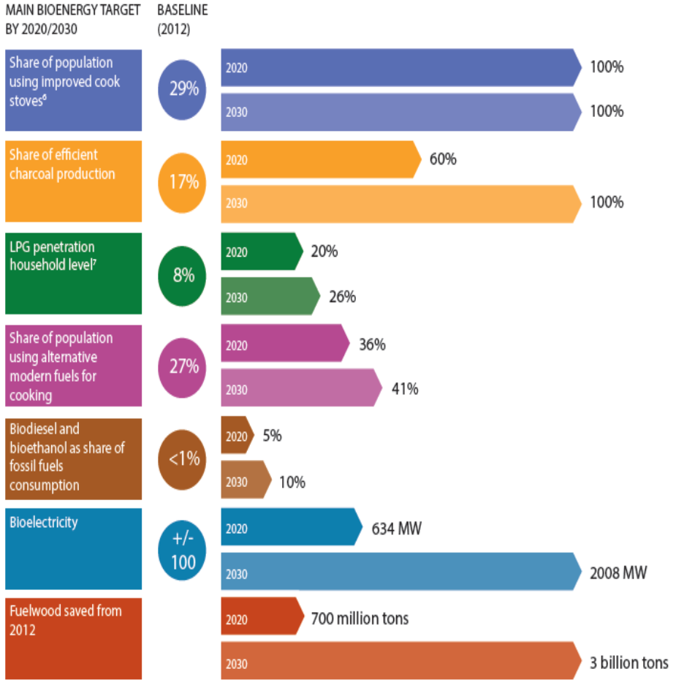
Rationale, vision and objectives Bioenergy target by 2030
10

Slide 11
Rationale, vision and objectives: Bioenergy targets by 2020
What are the expected impacts of Universal access to clean, safe and affordable cooking energy, including 20% of LPG users ?.
over 10 million of additional household users of LPG as primary fuel as compared to 2012,
15 million additional households using ICS as main cooking device and/or sustainable biomass fuel as primary fuel,
700 million tons of wood saved between 2012 and 2020 e.g. 18 billion USD
26 % of electricity from Renewable Energy source (2,425 MW) in the region; of which 634 MW is generated from biomass residues or dedicated plantations with the deployment of various technologies and application including
11

Slide 12
Rationale, vision and objectives: Bioenergy target by 2030
What are the expected impact of universal access to clean, safe and affordable cooking energy, including 26% of LPG users and 100% of improved cookstoves (ICS) and/or sustainable biomass fuels users.
3 billion tons of wood saved between 2012 and 2030.
Electricity from biomass will account for 5 % of the total installed capacity in the region, which corresponds respectively to 686 MW by 2020 (28% of RE capacity) and 2008 MW (13% of RE Capacity) by 2030.
12

Slide 13
Policy Implementation strategy Guiding Principles
Alignment with existing policies
The ECOWAS UEMOA White Paper
EREP
EEEP
ECOWAS Bioenergy Strategy Framework,
Pan African Bioenergy Policy Framework and Guidelines.
13

Slide 14
Policy Implementation strategy Guiding Principles
Good governance
Strengthen and harmonizing forest and fiscal policies;
Decentralization and devolution of authority to rural communities;
Establishing mechanisms for broad stakeholder consultation and engagement;
Defining clear responsibilities for the stakeholders and transparent mechanisms to design, implement and monitor the bioenergy policy
Ensuring transparent mechanisms to attract and to protect private sector investments
Inclusive Participation (women should play an important role.
The following need to be considered
The needs and constrains of small farmers, cooperatives and associations involved in activities of primary processing of bioenergy crops and residues.
Civil society organisations, private sector, local communities and municipalities from the outset.
Ensure women play an important role in the bioenergy value chain.
14

Slide 15
Policy Implementation strategy Pillars for policy implementation
Policy support to enhance local governance
Government support, in the form of policy, regulations, and/or incentives, has been instrumental in driving bioenergy markets worldwide
Capacity Building and technology transfer
Capacity-building is a long-term, continuous and complex process that requires clear policies and the active cooperation of all involved stakeholders. For bioenergy markets to develop and deepen, capacity building is required in all areas of project and program design, development, installation, operation and maintenance.
Knowledge management and awareness raising
In the implementation of the bioenergy policy, it is necessary to increase knowledge and awareness on potential risks and opportunities associated with bioenergy development. As information and data are an essential part of appropriate policy development and implementation, information and data on bioenergy should be collected and shared through various knowledge sharing platforms
15

Slide 16
Policy Implementation strategy Pillars for policy implementation
Environment, land tenure and social equity
A long-term successful bioenergy strategy needs to take into account sustainability issues. Therefore a number of initiatives, policies and standards related to biomass sustainability are currently under development.
Financial instruments
Finance and investments are key to the growth and development of bioenergy. As the industry expands and develops, financing sources and instruments, both locally and internationally, must be increased. More creative leveraging of public and private sector resources will be needed to meet the financing requirements of the bioenergy industry, including from a variety of public and private sector sources.
16

Slide 17
Policy Implementation strategy Implementation arrangements
Implementation plan at the regional level
ECREEE as the technical arm of ECOWAS to takes the leading role in the process in collaboration with the Member states.
17

Slide 18
Policy Implementation strategy Implementation arrangements
Implementation plan at country level
Role of National Governments
Embedding the bioenergy policy into national development plans with adequate legal provisions.
Assessing and mapping the bioenergy potential.
Risk prevention and management through promotion of good environmental and socio-economic practices in bioenergy feedstock production and use, and thorough screening of investment proposals.
Improving land tenure, forestry and water resources governance to avoid the negative impact on food security and marginalization of the poor.
Setting environmental standards, creating an attractive investment environment, and providing supportive monetary, fiscal, and pricing policies..
Establishing corporate social responsibility (CSR) guidelines for companies to ensure sustainability and to prevent conflicts.
Building capacities for policy planning and implementation, investment planning, negotiation, choice of feedstock and technology, and concluding economically, socially and environmentally acceptable arrangements.
18

Slide 19
Policy Implementation strategy Implementation arrangements
Implementation plan at country level
Role of National Governments
Involving relevant government departments.
Engaging local communities in the formulation and implementation processes, both as producers and ultimate beneficiaries.
foster bioenergy production chains which have the minimum impact on food security;
Establishing a national bioenergy research and innovation community;
Transparency :establishing a national platform with unbiased and updated information;
Introduce appropriate incentives such as feed-in-tariffs, fixed price guarantees, tradable green certificates for bioenergy;
Introducing time-limited bioenergy support policies linked to clear objectives with a view to an economically viable industry, including phasing out of subsidies for fossil fuels;
Promoting innovative financing for bioenergy projects;
Introducing proper impact monitoring, evaluation and response mechanisms.
19

Slide 20
Policy Implementation strategy Implementation arrangements
Implementation plan at country level
Role of the private sector and civil society
The private sector is ultimately the engine of bioenergy development.
Civil Society Organisations: watchdog for government and business actions. Stimulate sustainable business models and good practices for bioenergy investments.
SMEs have a special role in the development of sustainable bioenergy given their great capacity to involve local communities.
Large industrial and agricultural processing companies should be encouraged to develop bioenergy production units from their own waste streams.
20

Slide 21
Policy Implementation strategy Developing monitoring systems
Developing monitoring systems
Purpose : detect, measure and register all relevant challenges and performances against benchmarks due to bioenergy policies implementation and provide feedback to policymakers and other stakeholders.
Measuring and analysing the impacts of national bioenergy policies (achievement of targets, budget control and impact assessment).
Analysing sustainability of land and water use, GHG emissions, biodiversity and other socioeconomic effects.
Introducing and monitoring certification schemes to guarantee sustainability and traceability of bioenergy products.
Tracking system for land tenure transactions and legal cases
Gathering and analysing statistics (agricultural, forestry, environment and energy) that are directly fed into the existing Energy Information Systems.
21

Slide 22
Policy Implementation strategy Relevant data to be monitored
Relevant data to be monitored
Data to be collected include but not limited to:
Access to modern energy and impact on livelihoods, including food prices,
Land prices and tenure systems
Availability of food,
Relocation of food production and cattle breeding,
Changes in land cover, including deforestation.
22

Slide 23
Planning for the implementation of the policy
Milestones
Dissemination and ownership of the regional policy by Members States by end 2015
Adoption of a National Bioenergy Policy by the ECOWAS Members States by end 2017
Development of a set of investment guidelines and supporting documents addressing the resources availability and potential for a bioenergy market development in the Region made available by end 2016;
Embark on robust sensitization activities to create awareness on the use and benefits of sustainable bioenergy
Support capacity building of Member States on bioenergy technical, policy and regulatory aspects
Business and investment models based on best social and environmental practices for various types of bioenergy projects are produced by ECREEE and disseminated in the Region to attract potential investors
Facilitate about 50 bankable projects (i.e. feasibility studies, engineering designs) by the end 2018 leveraging USD 500 million investment and the creation of job opportunities for at least 100,000 people
23

Slide 24
Planning for the implementation of the policy
Aactivities to be implemented by ECREEE
Organizing a series of consultations, workshops and events focused on specific proposed policies to share the policy document with the Members States and relevant partners
Identify minimum standards for the whole bioenergy value chain
Support Member States in their processes towards the development of a national bioenergy policy and action plan
Support capacity building of Member States on bioenergy technical, policy and regulatory aspects
Research and documentation, feasibility studies, gathering experiences, resource assessment and mapping, identification of suitable supply chain models
Technical Assistance (awareness, training, capacity development) to all stakeholders, including private companies, cooperatives, associations, local experts/consultants on bioenergy technology, and business developers
Direct technical assistance to 50 sustainable bioenergy projects to reach bankability
Promote at least 200 community-based projects
Establish with development banks appropriate financial mechanisms (e.g. a guarantee fund) that will enable to leverage USD 1 billion investments
Continuous evaluation and monitoring of funded projects
Organization of Public Private Partnership events for dialogue and business opportunities
24

Slide 25
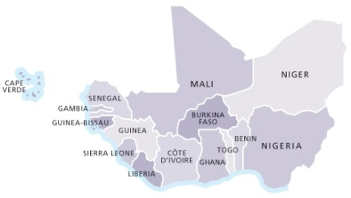

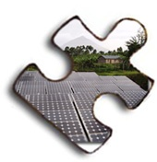



Thank you! Merci! Muito obrigado!
Achada Santo Antonio, 2nd Floor, Electra Building, C.P. 288, Praia – Cape Verde Tel: +2382624608, +2389225454 skype: info-ecreee info@ecreee.org
9/28/15
25

Slide 26
Policy Implementation strategy Key Areas for Bioenergy Policy
Main groups of biomass feedstock:
Solid biomass (wood, crop residues, agro-processing residues)
Digestible organic wastes (dung, nightsoil, waste water, etc.)
Sugars and starches
Vegetable oils and fats
Main conversion processes:
Combustion, including stoves (heat / electricity)
Gasification (electricity / heat)
Densification (briquettes, pellets)
Carbonisation (charcoal)
Anaerobic digestion (electricity / heat / mechanical power)
Fermentation / distillation (ethanol)
Extraction / transesterification (PPO / biodiesel)
26

Slide 27
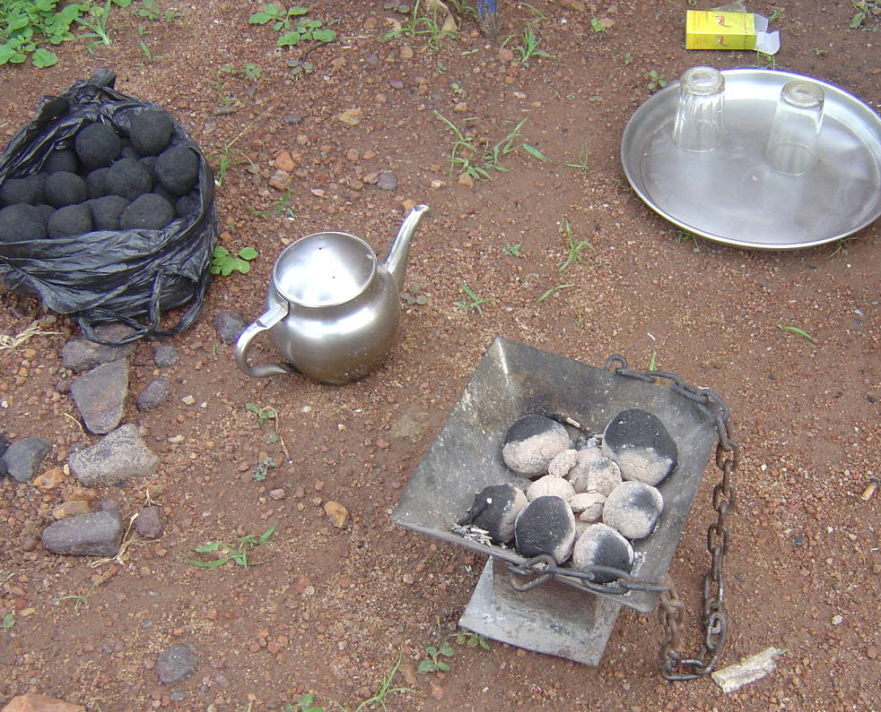
Policy Implementation strategy Key Areas for Bioenergy Policy
1. Wood, crop residues, agro-processing residues
Improved cooking stoves: in combination with solid biomass fuels. High fuel efficiency, reduced indoor pollution. Must be bought but typically highly economic investment
Carbonisation: charcoal from wood or other lignocellulotic biomass. Improved production methods have higher efficiency and lower emissions but can have high investment costs
Charcoal briquettes produced from cotton stalk in Mali
27

Slide 28
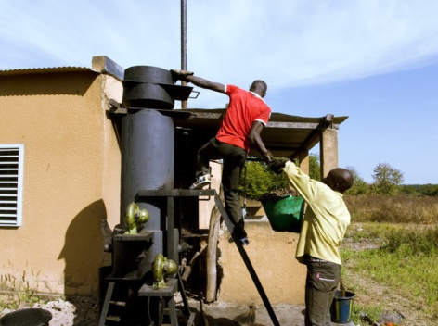
Policy Implementation strategy Key Areas for Bioenergy Policy
Densification: biomass briquettes and pellets from solid biomass. Mainly for domestic energy; can replace fuelwood (reduce deforestation) but often more expensive
Gasification: conversion of solid biomass into gas for electricity production and industrial heat. Relatively efficient and limited investment costs, but difficult to operate and maintain
Rice husk gasifier in Dano, Burkina Faso
28

Slide 29
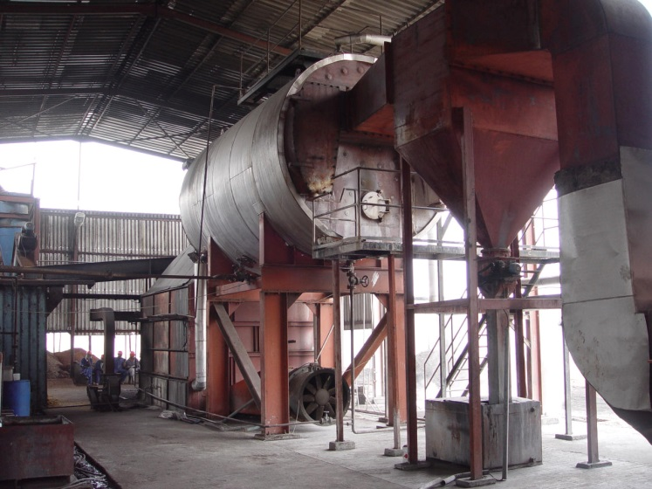
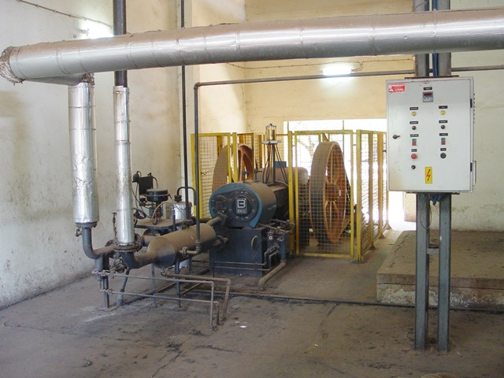
Policy Implementation strategy Key Areas for Bioenergy Policy
Combustion for CHP / industrial heat: typically grid connected systems. Efficient at larger scale, but high investment costs and large biomass quantities required.
EFB fired steam boiler at 450 kWe CHP plant of Juaben oil mill, Ghana
60 kWe Steam engine run on cashew shell at SICAJU in Guinea Bissau
29

Slide 30
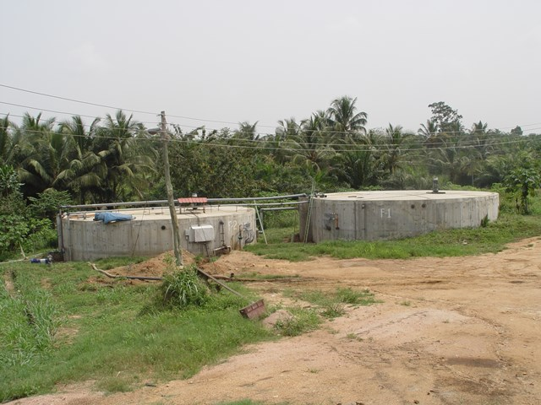
Policy Implementation strategy Key Areas for Bioenergy Policy
2. Digestible organic wastes
Small biogas: for household and institutional use (cooking and lighting). Typically from animal dung and nightsoil. Clean fuel but relatively high investment costs.
Biogas for modern energy: for electricity, mechanical power, industrial heating. Usually at larger scale, using range of feedstocks. Most attractive in remote areas (high alternative fuel costs).
900m³ biogas system running on fruit processing wastes at HPW Fresh& Dry in Ghana
30

Slide 31
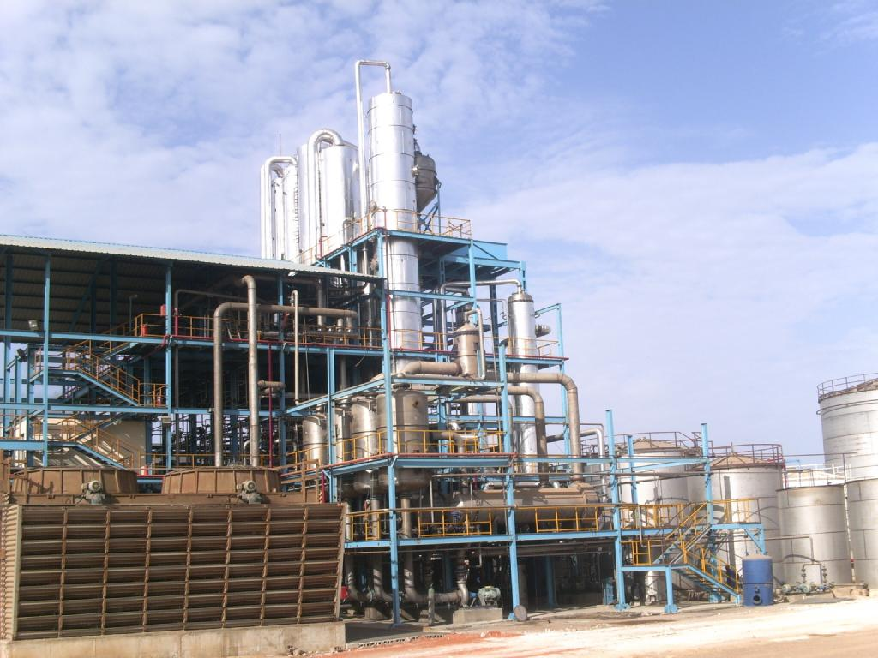
Policy Implementation strategy Key Areas for Bioenergy Policy
3. Sugar, starch
Bioethanol: from fermentation of sugars and starches and subsequent distillation / rectification. Use as automotive fuel (blending with gasoline). Large scale production is efficient but high investment costs.
Liquid household fuels: in liquid or gellified form, used in dedicated household stoves. Clean but relatively expensive.
12 million l/a ethanol plant at CSS sugar factory in Richard Toll, Senegal
31

Slide 32
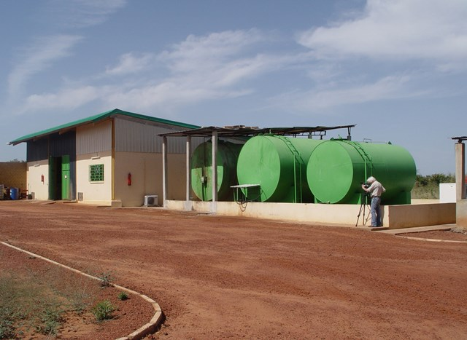
Policy Implementation strategy Key Areas for Bioenergy Policy
4. Vegetable oils and fats
Pure Plant Oil: for use in (adapted) diesel engines. PPO can be produced locally – attractive in remote areas. Issues are potential food market distortions and oil quality.
Biodiesel: for use in diesel engines, neat or blended. Produced through transesterification of oils or fats. Industrial process, cost-efficient at larger scales.
2000 l/d biodiesel plant of Mali Biocarburant, Mali
32

Slide 33
Thank you! Merci! Muito obrigado!
Achada Santo Antonio, 2nd Floor, Electra Building, C.P. 288, Praia – Cape Verde Tel: +2382624608, +2389225454 skype: info-ecreee info@ecreee.org
9/28/15
33

