Slide 1
Impacts of Grid Regulation Policies in the United States Renewable Energy Market
Victoria Healey, Project Leader
ECOWAS Renewable Energy Investment Forum
09 Oct 2013

Slide 2
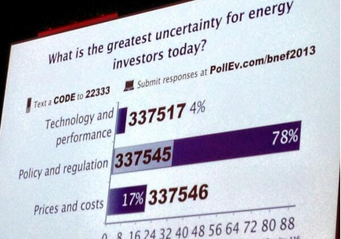
Quick poll of investors at BNEF 2013 Summit
Notes:
I think a good stating point for this discussion is to take a quick look at responses captured from clean energy investors that attended the Bloomberg New Energy Finance Summit in May. Bloomberg took a series of poll questions during the summit. This slide tells the story of how investors view issues when looking at uncertainties they consider when investing in clean energy projects. While not a rigorous scientific peer reviewed analysis, this snapshot poll shows that 78% of the attendees stated policy & regulation uncertainties are the greatest source of concern for energy investors today. This response clearly demonstrates the need for stable, well defined policies to encourage investment

Slide 3
A bit of history: PURPA
Federal Public Utilities Regulatory Policies Act (PURPA) of 1978 created new class of non-utility generators that produced electricity specifically from renewable resources.
Utilities required to purchase electricity from qualifying facilities under long-term contract at prices set by the state
Electricity deregulation in the 1990s created greater opportunity for independent power producers (IPPs) to get involved in the generation business
IPPs frequently sell the power from their plants under long-term power purchase agreement (PPA) contracts
Notes:
The earliest grid-connected wind plants in the US were built in the early 1980s under PURPA7

Slide 4
What attracts investors?
Predictability
Coherent energy policy with clear direction
Regional strategy – markets that extend across borders
Appropriate governance structures
Competition body
Assigned regulatory body
Consumer representation
Bankable, such as feed-in tariffs
Notes:
Investors like to see markets linked with their neighbors and that appropriate governance structures are in place. What I mean by governance structures are putting in place a competition body, assigned regulatory body, and consumer representation. Based on this criteria, ECOWAS is well structured to attract investments.

Slide 5
RE has achieved varying degrees of penetration
Country | % Renewable Generation (2010)
Australia | 8%
China | 19%
Denmark | 34%
Germany | 18%
India | 15%
Ireland | 13%
Mexico | 18%
Spain | 34%
Thailand | 8%
United Kingdom | 7%
United States | 11%
Highest penetration on annual basis
Source: U.S. EIA, International Energy Statistics
Notes:
For a bit of perspective I’ve included a snapshot of the countries with the highest renewable grid penetration on an annual basis. The U.S. comes in at 11%, which is at the lower end of the countries represented on this chart. It could be argued that this ranking is at least partially attributed to the complexities and inconsistencies of regulations existing in the states, and the unpredictability of our national polices For example, some states, such as Texas have deregulated their electricity markets allowing for market competition, while neighboring states are regulated. On the national level, the Production Tax credit, which I will speak to in a moment, is cyclical. There is a pattern of repeated expiration and short-term renewals that has proven somewhat detrimental to RE markets, particularly wind, in that the investors are hesitant to make long-term investments.

Slide 6
Overview
U.S. Federal Policies
Investment Tax Credit
Production Tax Credit
Impacts of Treasury 1603 cash grants
Projects that began construction by end of 2013
Up to 30% of
State Policies
Renewable Portfolio Standards
Interconnection
Net Metering
Power Purchase Agreements
Notes:
It is important to note, that a great deal of policies that spur growth of renewable energy deployment are created and driven by the states. At the Federal level, the most polices with the most impact are the investment tax credit and the production tax credit. I would be remiss if I did not mention the 1603 program that supported renewable energy development implemented under the American Reinvestment and Recovery Act.

Slide 7

Investment Tax Credit
30% for solar, fuel cells, small wind and PTC-eligible technologies;*
10% for geothermal, micro-turbines and CHP
eligible systems placed in service on or before December 31, 2016
Notes:
Solar Water Heat, Solar Space Heat, Solar Thermal Electric, Solar Thermal Process Heat, Photovoltaics, Landfill Gas, Wind, Biomass, Hydroelectric, Geothermal Electric, Fuel Cells, Geothermal Heat Pumps, Municipal Solid Waste, CHP/Cogeneration, Solar Hybrid Lighting, Hydrokinetic Power (i.e., Flowing Water), Anaerobic Digestion, Small Hydroelectric, Tidal Energy, Wave Energy, Ocean Thermal, Fuel Cells using Renewable Fuels, Microturbines, Geothermal Direct-Use
PTC = Allowed eligible PTC systems have option to take the Investment tax credit
Landfill Gas, Wind, Biomass, Hydroelectric, Geothermal Electric, Municipal Solid Waste, Hydrokinetic Power (i.e., Flowing Water), Anaerobic Digestion, Small Hydroelectric, Tidal Energy, Wave Energy, Ocean Thermal

Slide 8

Renewable Energy Production Tax Credit
2.3¢/kWh for wind, geothermal,
closed-loop biomass; 1.1¢/kWh for other eligible
technologies. Generally applies to first
10 years of operation
Begin construction by 31 Dec 13
Uncertainty of return of PTC drives
investment volatility
Power purchase agreement negotiations are
impacted by PTC renewal uncertainty
Example: Wind industry sees a “boom-bust”
cycle in investment . Detrimental as ramp-up and
ramp down costs are high
Notes:
the pattern of repeated expiration and short-term renewal of the federal production tax credit (PTC) causes a boom–bust cycle in wind power plant investment in the US. This on–off pattern is detrimental to the wind industry, since ramp-up and ramp-down costs are high, and players are deterred from making long-term investments. It is often assumed that the severe downturn in investment during “off” years implies that wind power is unviable without the PTC. This assumption turns out to be unsubstantiated: that it is not the absence of the PTC that causes the investment downturn during “off” years, but rather the uncertainty over its return. Specifically, it is the dynamic of power purchase agreement (PPA) negotiations in the face of PTC renewal uncertainty that drives investment volatility. With contract negotiations prevalent in the renewable energy industry, this finding suggests that reducing uncertainty is a crucial component of effective renewable energy policy. The PTC as currently structured is not the only means, existing or potential, for encouraging wind power investment.
Source: Impact of public policy uncertainty on renewable energy investment: Wind power and the production tax credit
Merrill Jones Barradale

Slide 9
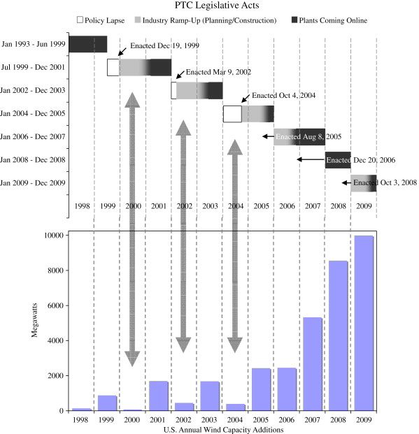
PTC Highs and Lows

Slide 10

Impacts of the Treasury 1603 Program
Allowed cash grant in lieu of PTC
88,245 projects funded
31.3 GW of installed nameplate capacity
$19.7 billion in cash payments
~ $69.3 billion of combined private and public investment represented for the Treasury 1603 program
Notes:
Source. U.S. Dept of Treasury

Slide 11
Renewable Portfolio Standards
Renewable Portfolio Standards – biggest driver in RE generation
Some RPS promote diversity through rules to promote specific technologies
Each state has a different requirement or goal
Those with specified requirements that impose penalties for non-compliance are making the difference
Notes:
They will have carve outs (primarily for solar) that a certain percentage of the renewables are provided from that technology. Example a 20% RPS may require that 5% of the renewables provided be from solar

Slide 12















































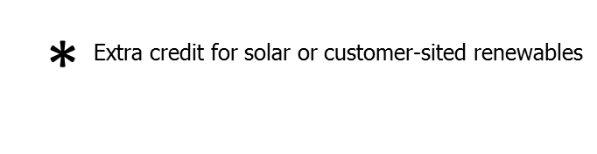



Renewable Portfolio Standard Policies..
www.dsireusa.org / March 2013.
29 states,+ Washington DC and 2 territories,have Renewable Portfolio Standards
(8 states and 2 territories have renewable portfolio goals).

Slide 13
Interconnection
Interconnection standards specify the technical and procedural process by which a customer connects an electricity-generating to the grid. Such standards include the technical and contractual terms that system owners and utilities must abide by. State public utilities commissions typically establish standards for interconnection to the distribution grid, while the Federal Energy Regulatory Commission (FERC) has adopted standards for interconnection to the transmission level. While many states have adopted interconnection standards, some states' standards apply only to investor-owned utilities (and not to municipal utilities or electric cooperatives).
Notes:
Two policies at the heart of current RE energy policy facilitating RE deployment. Interconnection standards specify the technical and procedural process by which a customer connects an electricity-generating to the grid. Such standards include the technical and contractual terms that system owners and utilities must abide by. State public utilities commissions typically establish standards for interconnection to the distribution grid, while the Federal Energy Regulatory Commission (FERC) has adopted standards for interconnection to the transmission level. While many states have adopted interconnection standards, some states' standards apply only to investor-owned utilities (and not to municipal utilities or electric cooperatives).

Slide 14
















































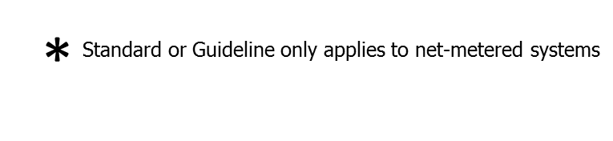

Interconnection Policies..
www.dsireusa.org / February 2013..
43 States,
+ Washington DC
and Puerto Rico,
have adopted an interconnection policy.
Notes: Numbers indicate system capacity limit in kW. Some state limits vary by customer type (e.g., residential versus non-residential).“No limit” means that there is no stated maximum size for individual systems. Other limits may apply. Generally, state interconnection standards apply only to investor-owned utilities.

Slide 15
Net Metering
For electric customers who generate their own electricity, net metering allows for the flow of electricity both to and from the customer – typically through a single, bi-directional meter. When a customer’s generation exceeds the customer’s use, electricity from the customer flows back to the grid, offsetting electricity consumed by the customer at a different time during the same billing cycle. In effect, the customer uses excess generation to offset electricity that the customer otherwise would have to purchase at the utility’s full retail rate. Net metering is required by law in most U.S. states, but state policies vary widely.

Slide 16















































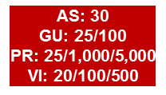

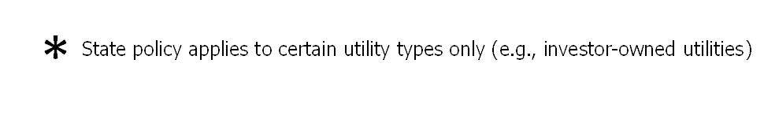
Net Metering.
www.dsireusa.org / July 2013
43 states,
+ Washington DC
& 4 territories,have adopted a net metering policy.
Note: Numbers indicate individual system capacity limit in kilowatts. Some limits vary by customer type, technology and/or application. Other limits might also apply. This map generally does not address statutory changes until administrative rules have been adopted to implement such changes.

Slide 17
Regulatory Environment
Each state, and in many cases, each utility has a different policy for renewable energy, for interconnection, for tariffs, and for incentives. This makes it costly for companies to replicate projects.
In places where the regulatory framework is more flexible, such as allowing third-party ownership of RE systems, or allowing for innovative partnerships and contracts, new models for renewable energy development have flourished.
Flexibility is different from no accountability. In places with deregulation has gone too far, the electricity grid has experienced repeated blackouts and high prices.
Lessons Learned:
Clear, consistent regulations and policies are important to investors and industry.
Regulatory flexibility can lead to innovative models for the RE market
All parties still need oversight and accountability in the sector.

Slide 18

Federal Energy Regulatory Commission
The use of renewable energy resources to generate electricity has the potential to be a cost-effective means not only to reduce greenhouse gas emissions, but also to diversify the fuels used to generate electricity. The Commission will continue to pursue market reforms to allow all resources, including renewable energy resources, to compete in jurisdictional markets on a level playing field. These efforts could include amendments to market rules, the modification or creation of ancillary services and related policies, or the implementation of operational tools that support the reliable integration of renewable resources. By implementing these or other reforms, the Commission's actions have the potential to increase the amount of electricity being produced from renewable energy resources.
Notes:
Distributed generation regulations are overseen by utilities, but when transmission crosses state lines, Centralized transmission, the Federal Energy Regulatory Commission is the overseeing agency. Their mission statement toward renewables is clear…make for a level playing field.

Slide 19

Lessons Learned
Consider renewable energy targets with requirements for compliance
Plan transmission in an integrated fashion considering both short-term and long-term needs, renewable resources, and current and future technologies
Streamline interconnection access for distributed renewables, but ensure they meet technical and safety standards
Provide net metering and other financial incentives to promote DG
Consider training and certification requirements for providers and minimum equipment specifications for suppliers.
Look for opportunities to connect existing RE systems to the grid as it extends to new areas. Don’t strand these assets – promote their use
Micro-grids or other innovative methods of using RE in conjunction with distributed generation can provide stronger, lower cost rural electrification.

Slide 20

Clean Energy Solutions Center http://www.CleanEnergySolutions.org
Goals
Serve as a first-stop clearinghouse of clean energy policy resources.
Share policy best practices, data, and analysis tools across countries.
Deliver dynamic services that will enable expert assistance, learning, and peer to peer sharing of experiences
Foster dialogue on emerging policy issues and innovation across the globe.
Target Audiences
Primary:
Secondary:
Energy policy makers and advisors
Analysts
Private sector companies,
Civil society
Others engaged in clean energy
Energy entrepreneurs and investors
Non Governmental Organizations
Notes:
The Solutions Center has four primary goals…
- It serves as a clearinghouse of clean energy policy resources
- it also serves to share policy best practices, data, and analysis tools specific to clean energy policies and programs
- The Solutions Center delivers dynamic services that enables expert assistance, learning, and peer to peer sharing of experiences
- and lastly, the Center fosters dialogue on emerging policy issues and innovation around the globe
Our primary audience is energy policy makers and analysts from governments and technical organizations in all countries, but
We also strive to engage with the private sector and civil society.

Slide 21
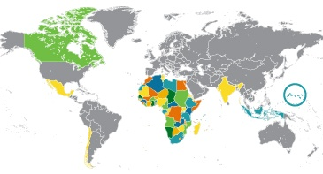
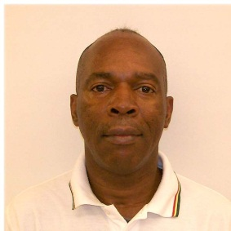

Ask an Expert: Our Experts in Action
We connect you to a global network of energy experts for personalized attention and quick response technical assistance on strategies, regulations, standards, financial incentives, and deployment programs for a broad range of clean energy sectors and technologies including:
Energy Access
Energy Efficiency
Renewable Energy
Smart Grid
Transportation
Utilities
Requesting Assistance:
Register on http://cleanenergysolutions.org/expert
Notes:
Ask an Expert is a valuable service offered through the Solutions Center. We have established a broad team of experts from around the globe who are available to provide remote policy advice and analysis to all countries at no cost. If you have a need for clean energy policy assistance we welcome and encourage you to use this valuable service. Again, this assistance is provided free of charge and to request assistance, you may register and submit your request through the Solutions Center ‘Ask an Expert’ feature at cleanenergysolutions.org/expert. We also invite you to spread the word about this service to those in your networks and organizations. Low-carbon and Sustainable Energy Planning Joseph Essandoh-Yeddu, Head of Strategic Policy and Planning Ghana Energy Commission
Some of the broad sectors covered by our experts include:
Energy access
Energy efficiency
Renewable Energy
Smart Grid
Micro-grid
Clean transportation and
Regulations and Utilities

Slide 22
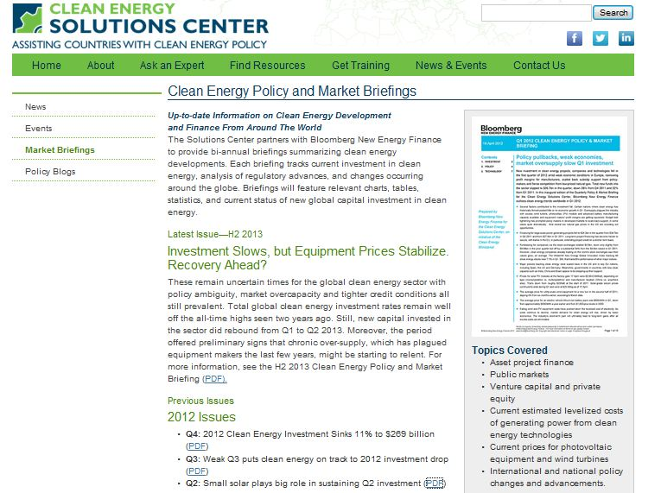
Bloomberg New Energy Finance: Policy & Market Briefings

Slide 23
Thank you
Victoria Healey
Victoria.Healey@nrel.gov

